Slide 1
Modern Statistics for Modern Biology
Susand Holmes & Wolfgang Huber
Chapter 2 background material

Slide 2
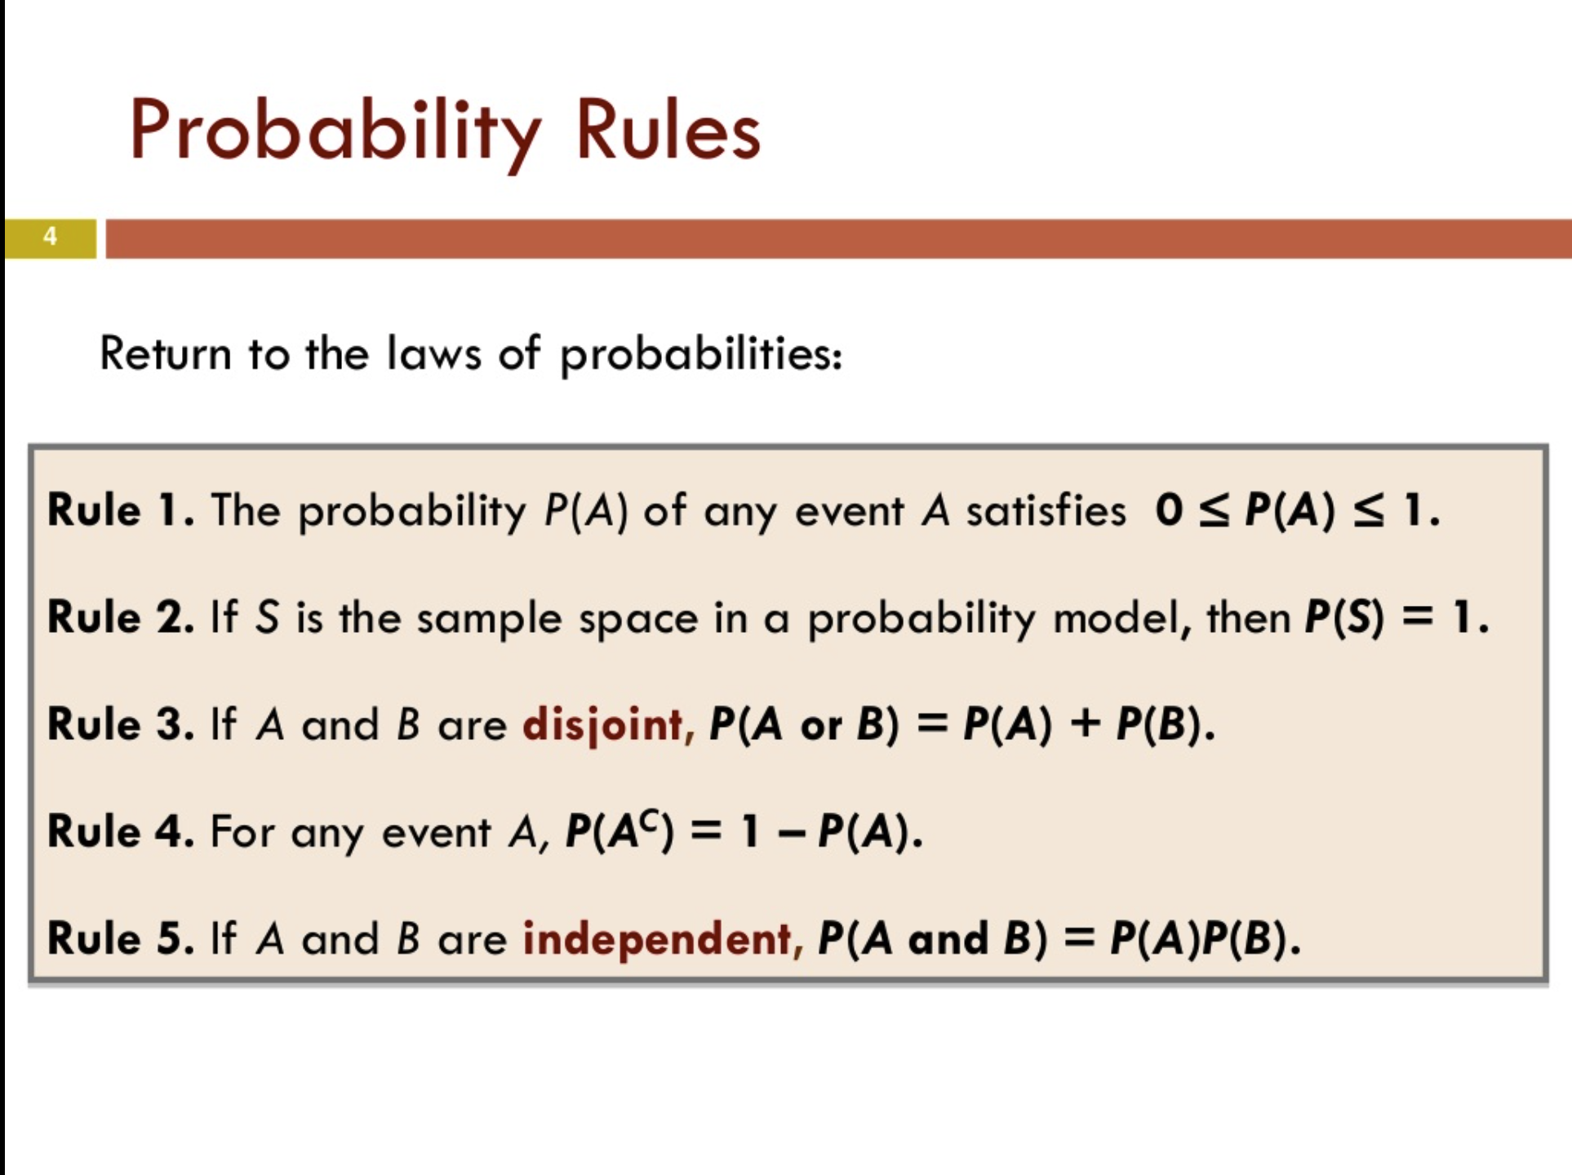
Dr. Nahid Sultana https://www.slideshare.net/nszakir/chapter-4-part4-general-probability-rules

Slide 3
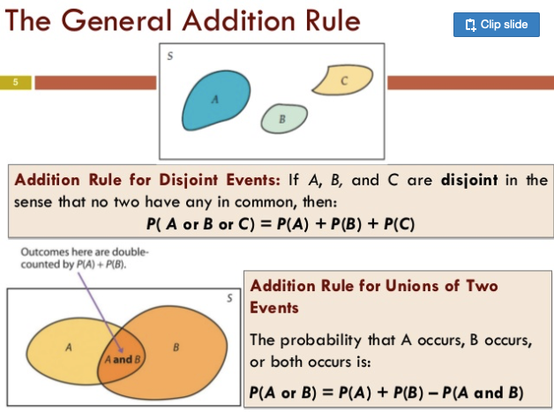
Dr. Nahid Sultana https://www.slideshare.net/nszakir/chapter-4-part4-general-probability-rules

Slide 4
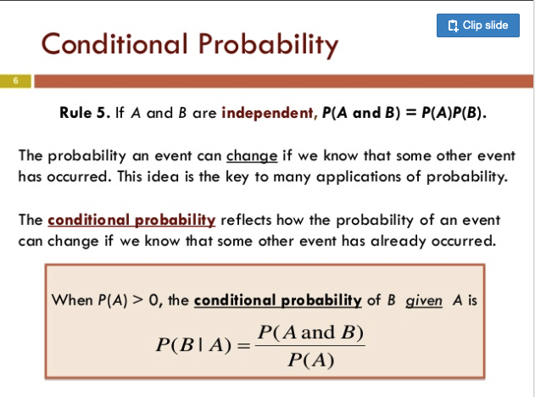
Dr. Nahid Sultana https://www.slideshare.net/nszakir/chapter-4-part4-general-probability-rules

Slide 5
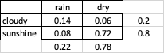
Conditional probability
Probability than an event (a) occurs, given that another event (b) has already occurred. It is written as: P(a|b)
0.7
rain
P(rain|cloudy)=0.2*0.7=0.14
conditional probabilities
cloudy
0.2
0.3
dry
P(dry|cloudy)=0.2*0.3=0.06
weather
rain
P(rain|sun)=0.8*0.1=0.08
0.8
0.1
sunshine
0.9
Marginal probabilities
dry
P(dry|sun)=0.8*0.9=0.72

Slide 6
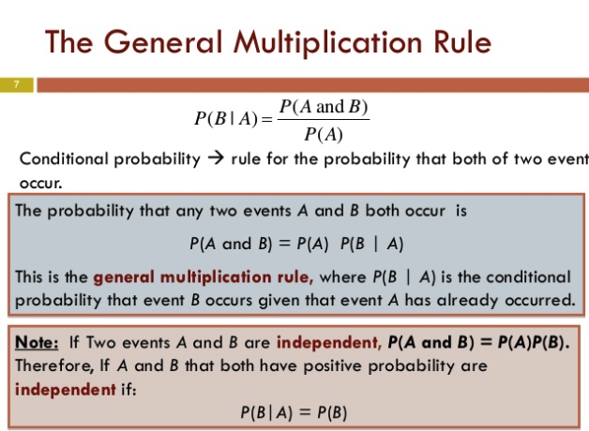
Dr. Nahid Sultana https://www.slideshare.net/nszakir/chapter-4-part4-general-probability-rules

Slide 7
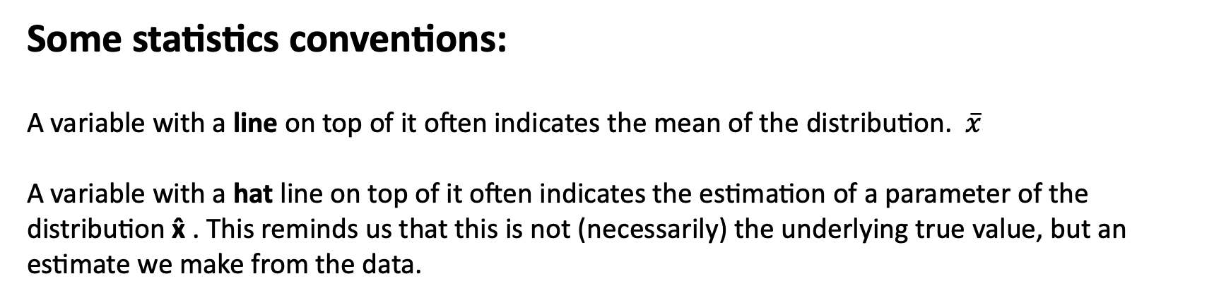
Some statistics conventions:
A variable with a line on top of it often indicates the mean of the distribution. $\overline{x}$
A variable with a hat line on top of it often indicates the estimation of a parameter of the distribution x̂ . This reminds us that this is not (necessarily) the underlying true value, but an estimate we make from the data.

Slide 8
Some linear algebra

Slide 9
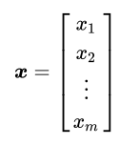
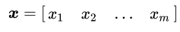
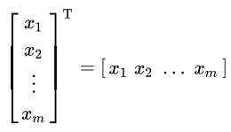
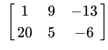
Vectors and matrices
A vector is essentially a list of numbers.
Column vector
row vector
To go from one to the other you transpose the vector.
In R the default vector is a row vector, so x=c(1,2,3) is a row vector and to get a column vector you need to transpose:
t(c(1,2,3))
A matrix of size 2x3 (always say row number first)
Matrices are simply a collection of row or column vectors of the same size:

Slide 10
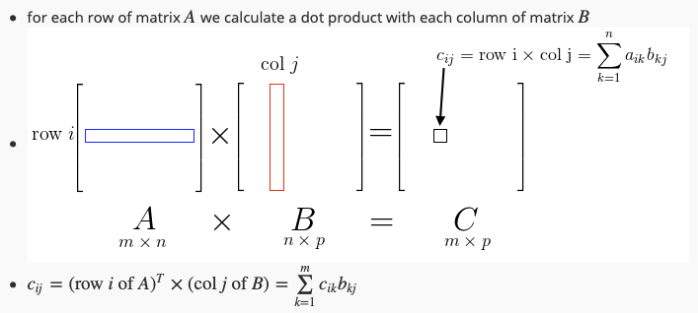
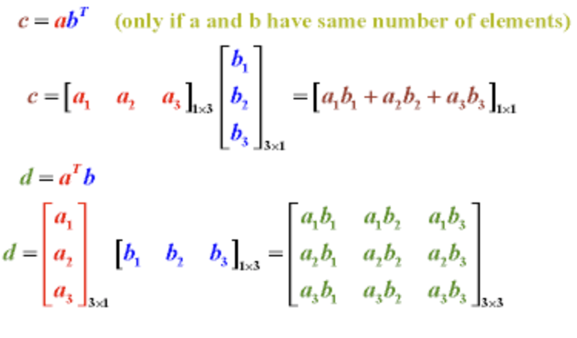
Inner product
Dot product
Dot product of two matrices
c=a^{T}b
Outer product
d=ab^{T}

Slide 11
Logarithms
0.001*0.001*0.01=0.00000001
Log(0.001)*log(0.001)*log(0.01)= (-3)*(-3)*(-2)=-18

Slide 12
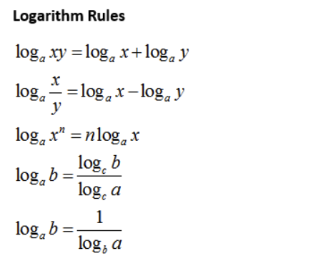
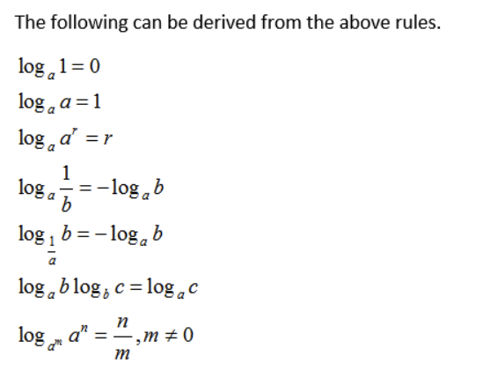

Slide 13
Some Calculus

Slide 14
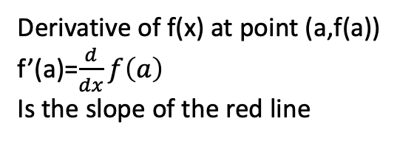
Derivatives
For a proper definition, see interactive illustrations in http://www.malinc.se/math/calculus/diffatpointen.php
Derivative of a function f(x) at point (a, f(a)) is the slope of the tangent to the function at that point
Point (a,f(a))
Derivative of f(x) at point (a,f(a))
f’(a)=$\frac{d}{dx}f\left(a\right)$
Is the slope of the red line
Function
y=f(x)

Slide 15
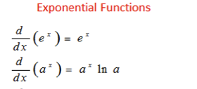
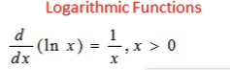
https://www.onlinemathlearning.com/derivative-rules.html

Slide 16
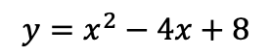
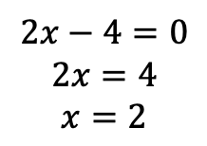
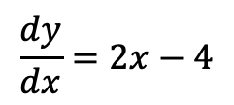
Finding the maximum and minimum of functions
At the maximum and minimum of curves, the slope of the tangent line is 0! (horizontal line).
That is why when doing optimisation or fitting, when we want to find the maximum or minimum of a
function (e.g. maximum log likelihood), we take the derivative, and set it to 0, and then solve for the variable.
Where (at what value of x) is the minimum of the function $y=x^{2}−4x+8$ ?
$$y=x^{2}−4x+8$$
First take derivative of the function $y=x^{2}−4x+8$ (see derivative rules):
$$\frac{dy}{dx}=2x−4$$
The slope at the minimum is 0 so we set the derivative to 0, and solve for x:
$$2x−4=0$$
$$2x=4$$
$$x=2$$
Same proceedure would apply if the parabola was inverted and we wanted to find the maximum.

Slide 17
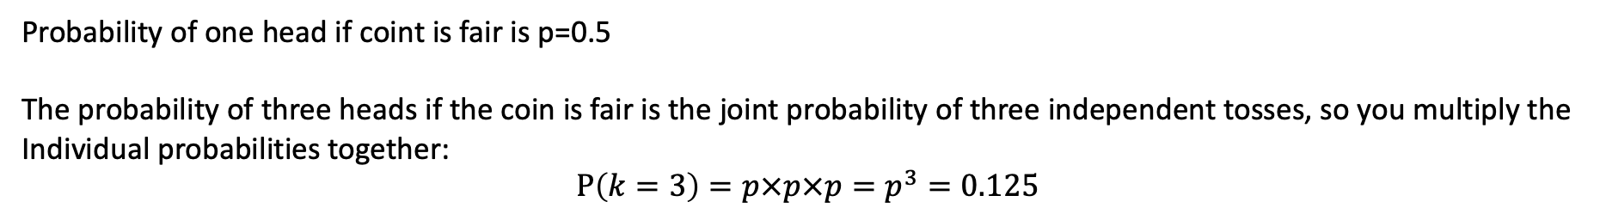
Likelihood function
The likelihood function (often simply called the likelihood) measures the goodness of fit of a statistical model to a sample of data for given values of the unknown parameters. It is formed from the joint probability distribution of the sample
Simple example: Toss a coin three times, and get three heads what is the likelihood that the coint is fair?
Probability of one head if coint is fair is p=0.5
The probability of three heads if the coin is fair is the joint probability of three independent tosses, so you multiply the
Individual probabilities together:
$$P\left(k=3\right)=p×p×p=p^{3}=0.125$$
Note this is the same as the density mass function of the binomial formula with k=3:
$$B\left(n=3,p=0.5\right)=\left({n \atop k}\right)p^{k} {(1−p)}^{(n−k)}=\left({3 \atop 3}\right){0.5}^{3}{0.5}^{(3−3)}={0.5}^{3}=0.125$$
The likelihood turns that question around:
What is the likelihood the coin is fair given you have gotten three heads in a row?
L$\left(p=0.5\right)|x=3)=\left({n \atop k}\right)p^{k} {(1−p)}^{(n−k)}=\left({3 \atop 3}\right){0.5}^{3}{0.5}^{(3−3)}={0.5}^{3}=0.125$

Slide 18
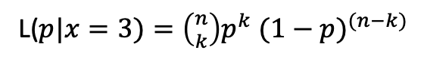
Maximum likelihood estimation
maximum likelihood estimation (MLE) is a method of estimating the parameters of a probability distribution by maximizing a likelihood function, so that under the assumed statistical model the observed data is most probable.
So we saw that the likelihood the coin was fair was fairly small: L(p=0.5)=0.125
Maximum likelihood estimates what is the most likely bias the coin has given we have three heads in a row?
L(p|k=3)
This is the maximum point of the likelihood function.
Our likelihood function for 3 heads was:
L($p|x=3)=\left({n \atop k}\right)p^{k} {(1−p)}^{(n−k)}$
We don’t like multiplying lots of small numbers so we take the log of both sides and simplify to get the log likelihood function:
Log(L($p|x=3))=k+xlogp+(n−x)log⁡(1−p)$
To find the maximum, we take the derivative and set it to 0. Some maths gives us: $p=\frac{x}{n}= \frac{3}{3}=1$
i.e. given that we did one trial and got three heads in a row, it is mostly likely that the coin is completely biased to heads

Slide 19
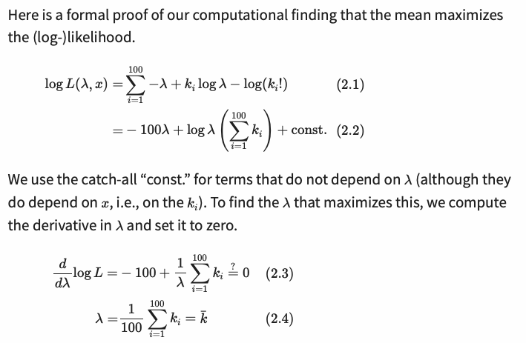
Proof that the mean of the Poisson distribution maximises the likelihood:
…. A more detailed working out is on the next slide….

Slide 20
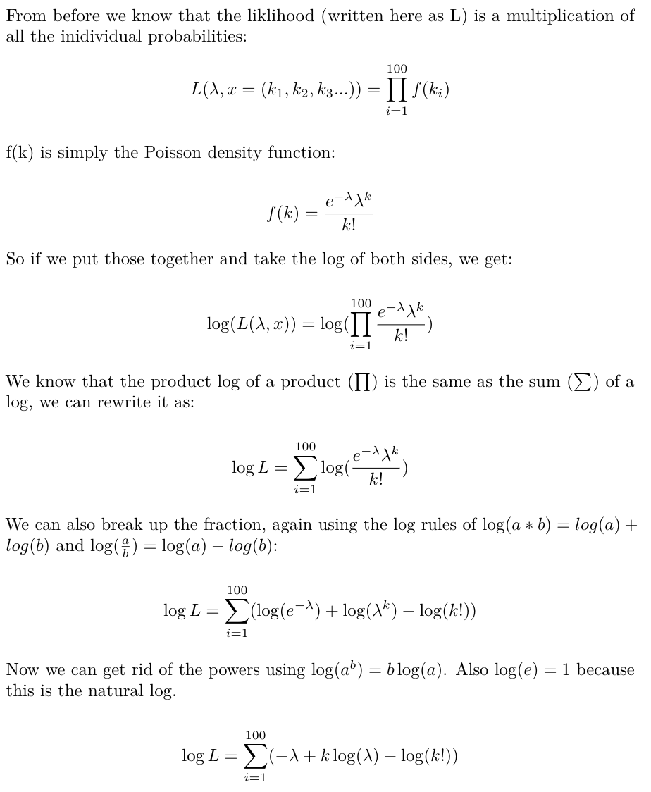
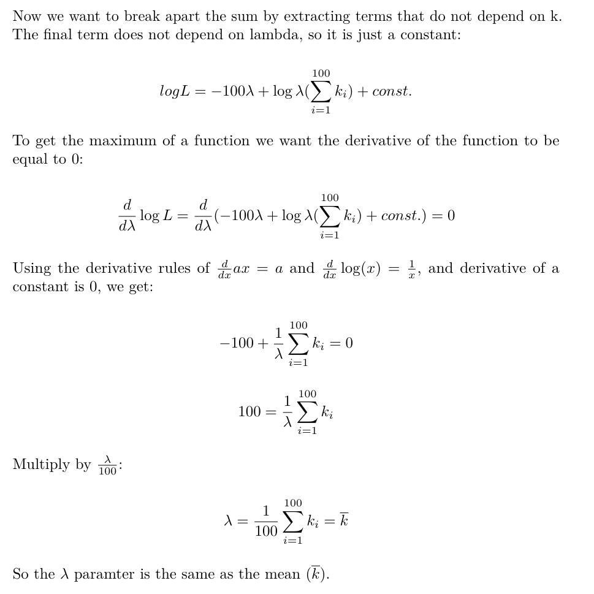
Proof that the mean of the Poisson distribution maximises the likelihood:

Slide 21
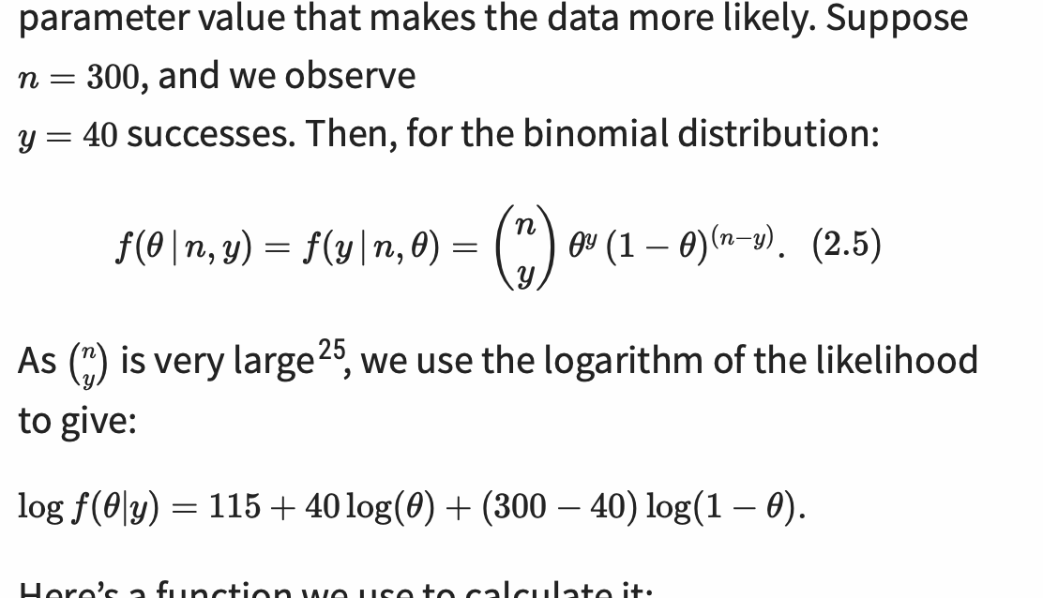
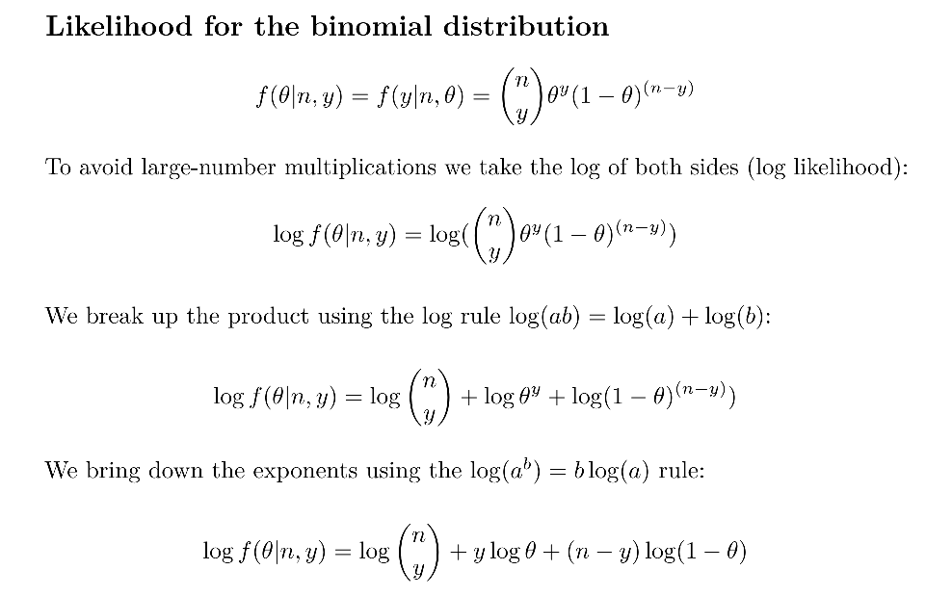
Likelihood for the binomial distribution

Slide 22
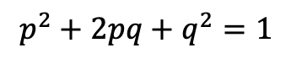
Hardy Weinberg equilibirium
Assume:
No natural selection
No mutation or migration
Infinite population size
Individuals in population mate randomly
Then:
Allele frequencies in population will not change from generation to generation
The expected genotype frequences of allelles p and q will be:
$$p^{2}+2pq+q^{2}=1$$
https://www.nature.com/scitable/knowledge/library/the-hardy-weinberg-principle-13235724/

Slide 23
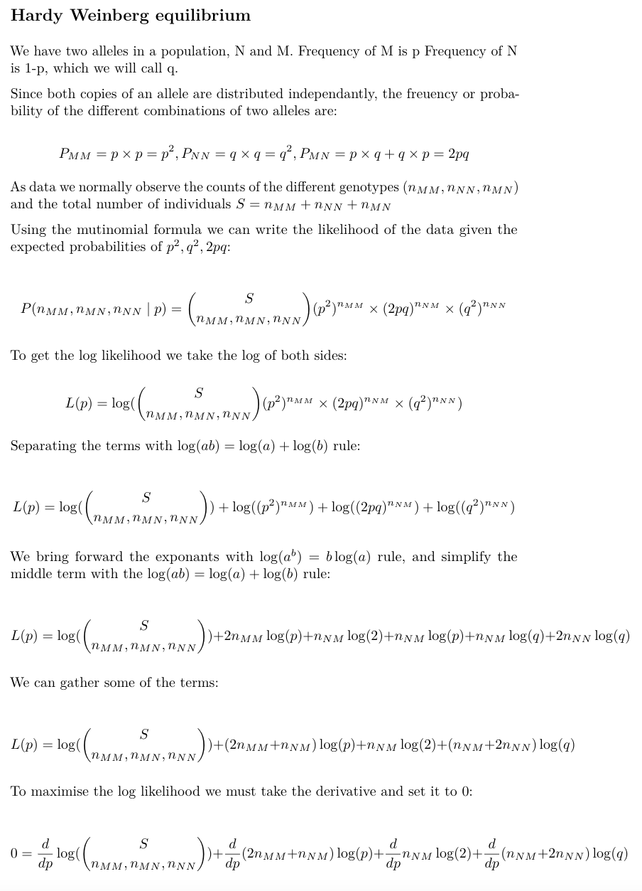
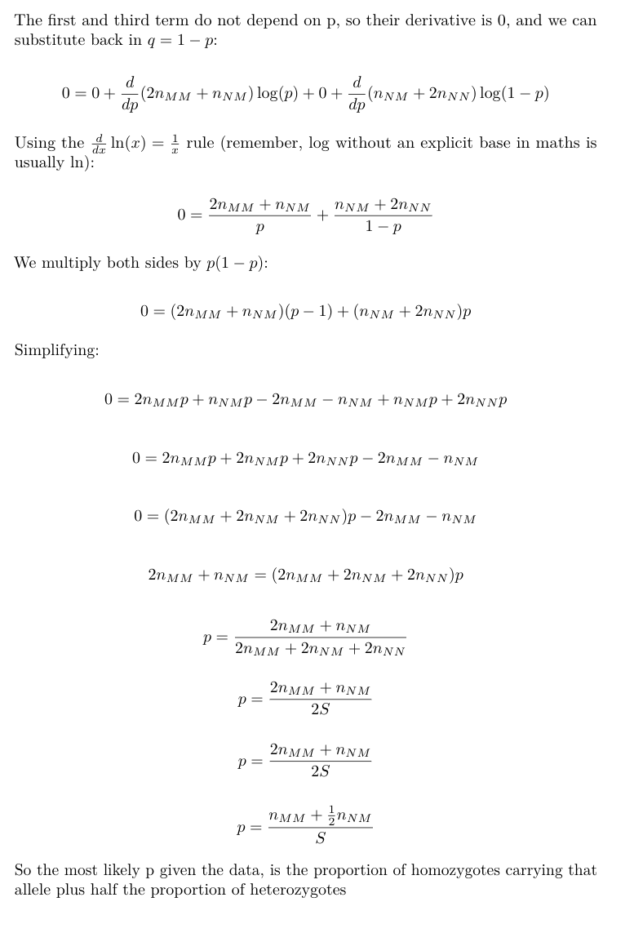

Slide 24
Markov chains
“finite memory process” where to know the probability of the next step, you only need to know the probability of the previous step
Imagine picking coloured balls out of a box, with replacement. If you have picked a ball of a certain colour (and put it back), what is the probability of picking out another ball of the same colour?
p=0.4
p=0.6
“Transition probabiliities”
Probability of going from one
state to another.
p=0.4
p=0.6
The new probability depends on the previous step: what was the first colour you picked? If it was yellow, then the probability of picking out the same colour ball is 0.6. If it was red, the probability is 0.4.
If you do this 100 times, the 101th probability will only depend on the colour picked in the 100th pick… not on the 99 picks before. i.e. finite memory

Slide 25
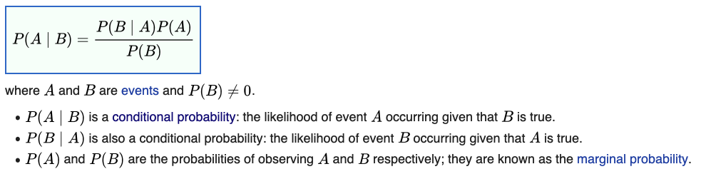
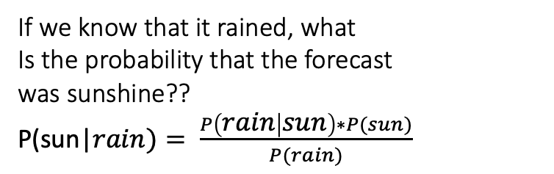
Bayes rule
rain
P(rain|cloudy)=0.2*0.7=0.14
If we know that it rained, what
Is the probability that the forecast
was sunshine??
P(sun|$rain)= \frac{P\left(rain | sun\right)∗P(sun)}{P(rain)}$
0.7
cloudy
0.2
0.3
dry
P(dry|cloudy)=0.2*0.3=0.06
weather
rain
P(rain|sun)=0.8*0.1=0.08
= 0.08*0.8/(0.14+0.08)= 0.29
0.8
0.1
sunshine
0.9
dry
P(dry|sun)=0.8*0.9=0.72

Slide 26
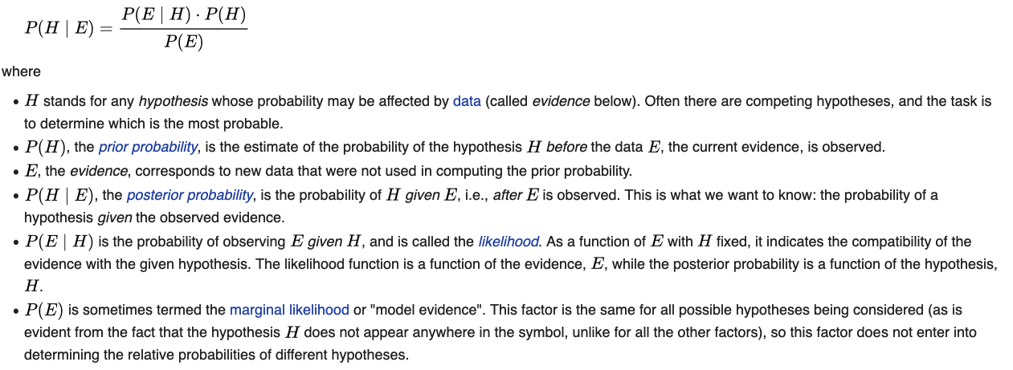
Bayesian inference
is a method of statistical inference in which Bayes' theorem is used to update the probability for a hypothesis as more evidence or informationbecomes available
E=evidence
H=hypothesis
What is the probability of our hypothesis given the evidence?
e.g. what is the probability our data comes from a Poisson distribution
given the distribution of our data?
Posterior
prob.
likelihood
Prior prob.
Marginal likelihood

Slide 27
In Bayesian statistics, a maximum a posterior probability (MAP) estimate is an estimate of an unknown quantity, that equals the mode of the posterior distribution. The MAP can be used to obtain a point estimate of an unobserved quantity on the basis of empirical data. It is closely related to the method of maximum likelihood (ML) estimation, but employs an augmented optimization objective which incorporates a prior distribution (that quantifies the additional information available through prior knowledge of a related event) over the quantity one wants to estimate. MAP estimation can therefore be seen as a regularization of ML estimation. (Wikipedia)
In Bayesian statistics, a credible interval is an interval within which an unobserved parameter value falls with a particular probability. It is an interval in the domain of a posterior probability distribution or a predictive distribution.^{[1]} The generalisation to multivariate problems is the credible region. Credible intervals are analogous to confidence intervals in frequentist statistics

Slide 28
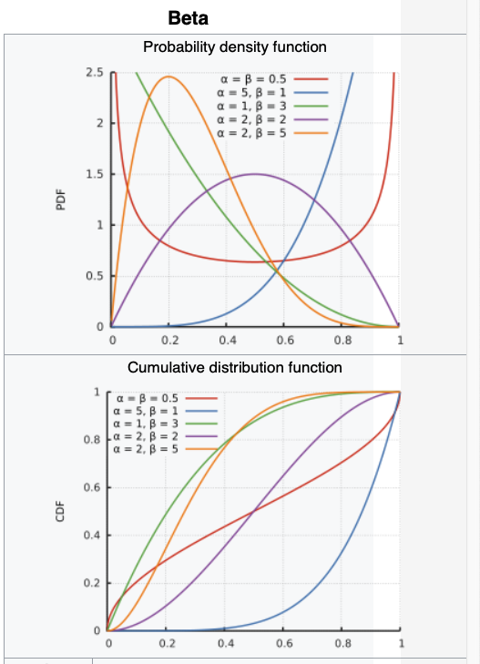
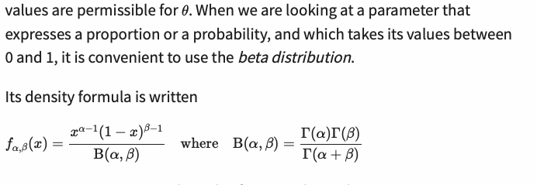
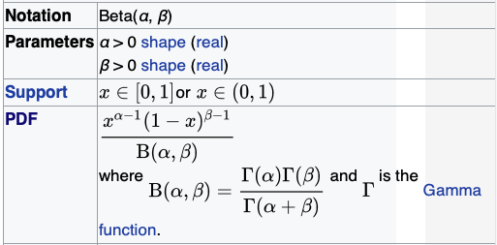
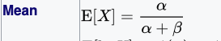

The beta distribution
Good for modelling probabilities, because it takes values between 0 and 1
It has two parameters: alpha and beta

